Slide 1
salaryball
Baseball player valuations have changed
Are their salaries following suit?

Slide 2
Alex’s Background

Slide 3
Anthony’s Background
Currently working in Education
Bachelor’s degree in Communications and Marketing
Data science is fascinating to me because it has the capacity to change just about everything it touches, it has the power to steer organizational decisions and change the way entire systems function

Slide 4
Project Background
Oakland A’s and the introduction of Analytics
A deep dive into the statistics of baseball
Focus on Player Values and Money that Teams Pay for that Value
How has salary changed over time?
How have player valuations changed?

Slide 5
Methods
Used data from 2 main sources:
Lahman’s Baseball Database & Baseball Reference’s WAR data
Lahman’s Database
Compiled by Sean Lahman, an award-winning reporter & sports statistician
The preeminent data source for baseball analysis
Consists of 24 different datasets on various baseball-related topics
We used: Batting, Pitching, Fielding, Salaries, People, & Teams

Slide 6
Methods
Datasets contained over 100,000 entries
Each entry represents one player’s performance for one season
Salary data only for 1985-2016
Subset data to create two different data frames for 1995-1999 & 2015-2019
Pre-sabermetric revolution and post-sabermetric revolution
BattingA: 6,363 entries
BattingB: 7,566 entries
PitchingA: 3,070 entries
PitchingB: 4,294 entries

Slide 7
Methods
Important Variables:
HR (BattingA): Min. 1st Qu. Median Mean 3rd Qu. Max.
0.000 2.000 5.000 9.279 13.000 70.000
HR (BattingB): Min. 1st Qu. Median Mean 3rd Qu. Max.
0.00 2.00 7.00 10.36 15.00 59.00
RBI (BattingA): Min. 1st Qu. Median Mean 3rd Qu. Max.
0.00 4.00 17.00 30.05 46.00 165.00
RBI (BattingB): Min. 1st Qu. Median Mean 3rd Qu. Max.
0.00 4.00 18.00 28.97 48.00 133.00
Salary (Salaries): Min. 1st Qu. Median Mean 3rd Qu. Max.
0 294702 550000 2085634 2350000 33000000

Slide 8
Methods
SO (PitchingA): Min. 1st Qu. Median Mean 3rd Qu. Max.
0.00 11.00 33.50 48.10 68.75 364.00
SO (PitchingB): Min. 1st Qu. Median Mean 3rd Qu. Max.
0.00 9.00 30.00 46.71 66.00 326.00
ERA (PitchingA): Min. 1st Qu. Median Mean 3rd Qu. Max.
0.000 3.660 4.760 5.768 6.260 162.000
ERA (PitchingB): Min. 1st Qu. Median Mean 3rd Qu. Max.
0.000 3.240 4.390 5.557 6.000 162.000
W (PitchingA): Min. 1st Qu. Median Mean 3rd Qu. Max.
0.000 0.000 2.000 3.715 5.000 24.000
W (PitchingB): Min. 1st Qu. Median Mean 3rd Qu. Max.
0.000 0.000 1.000 2.829 4.000 22.000

Slide 9
Methods
Baseball Reference Batting/Pitching WAR datasets
Compiled by Baseball Reference, an online encyclopedia which provides detailed statistics throughout the history of organized baseball
Consists of 2 separate datasets, one for batting metrics, one for pitching metrics
Contains new, advanced metrics such as Wins Above Replacement, OPS+, ERA+

Slide 10
Methods
Datasets contained over 100,000 entries
Each entry represents one player’s performance for one season
Subset data to create two different data frames for 1995-1999 & 2015-2019
warBatA, warBatB, warPitchA, & warPitchB
warBatA: 6,357 entries
warBatB: 7,253 entries
warPitchA: 3,067 entries
warPitchB: 4,293 entries

Slide 11
Methods
Important Variables:
Salary (warBatA): Min. 1st Qu. Median Mean 3rd Qu. Max.
109000 175000 300000 1195534 1500000 14936667
Salary (warBatB): Min. 1st Qu. Median Mean 3rd Qu. Max.
100000 555000 1550000 4468661 6000000 42143000
Salary (warPitchA): Min. 1st Qu. Median Mean 3rd Qu. Max.
109000 170000 265000 1034818 1100000 11100000
Salary (warPitchB): Min. 1st Qu. Median Mean 3rd Qu. Max.
100000 555000 1350000 3932439 5000000 42143000

Slide 12
Methods
WAR (warBatA): Min. 1st Qu. Median Mean 3rd Qu. Max.
-3.2600 -0.0800 0.0000 0.5046 0.4800 9.8400
WAR (warBatB): Min. 1st Qu. Median Mean 3rd Qu. Max.
-2.7500 -0.0400 0.0000 0.4307 0.2800 10.8600
WAR (warPitchA): Min. 1st Qu. Median Mean 3rd Qu. Max.
-3.1700 -0.2300 0.1600 0.6284 1.1000 11.9300
WAR (warPitchB): Min. 1st Qu. Median Mean 3rd Qu. Max.
-2.2900 -0.1800 0.1000 0.4783 0.7800 10.4600

Slide 13
Methods
Age (warBatA): Min. 1st Qu. Median Mean 3rd Qu. Max.
19.0 25.0 28.0 28.2 31.0 44.0
Age (warBatB): Min. 1st Qu. Median Mean 3rd Qu. Max.
19.00 25.00 27.00 27.99 30.00 45.00
Age (warPitchA): Min. 1st Qu. Median Mean 3rd Qu. Max.
19.00 25.00 27.00 28.05 31.00 44.00
Age (warPitchB): Min. 1st Qu. Median Mean 3rd Qu. Max.
19.00 25.00 27.00 28.03 30.00 45.00

Slide 14
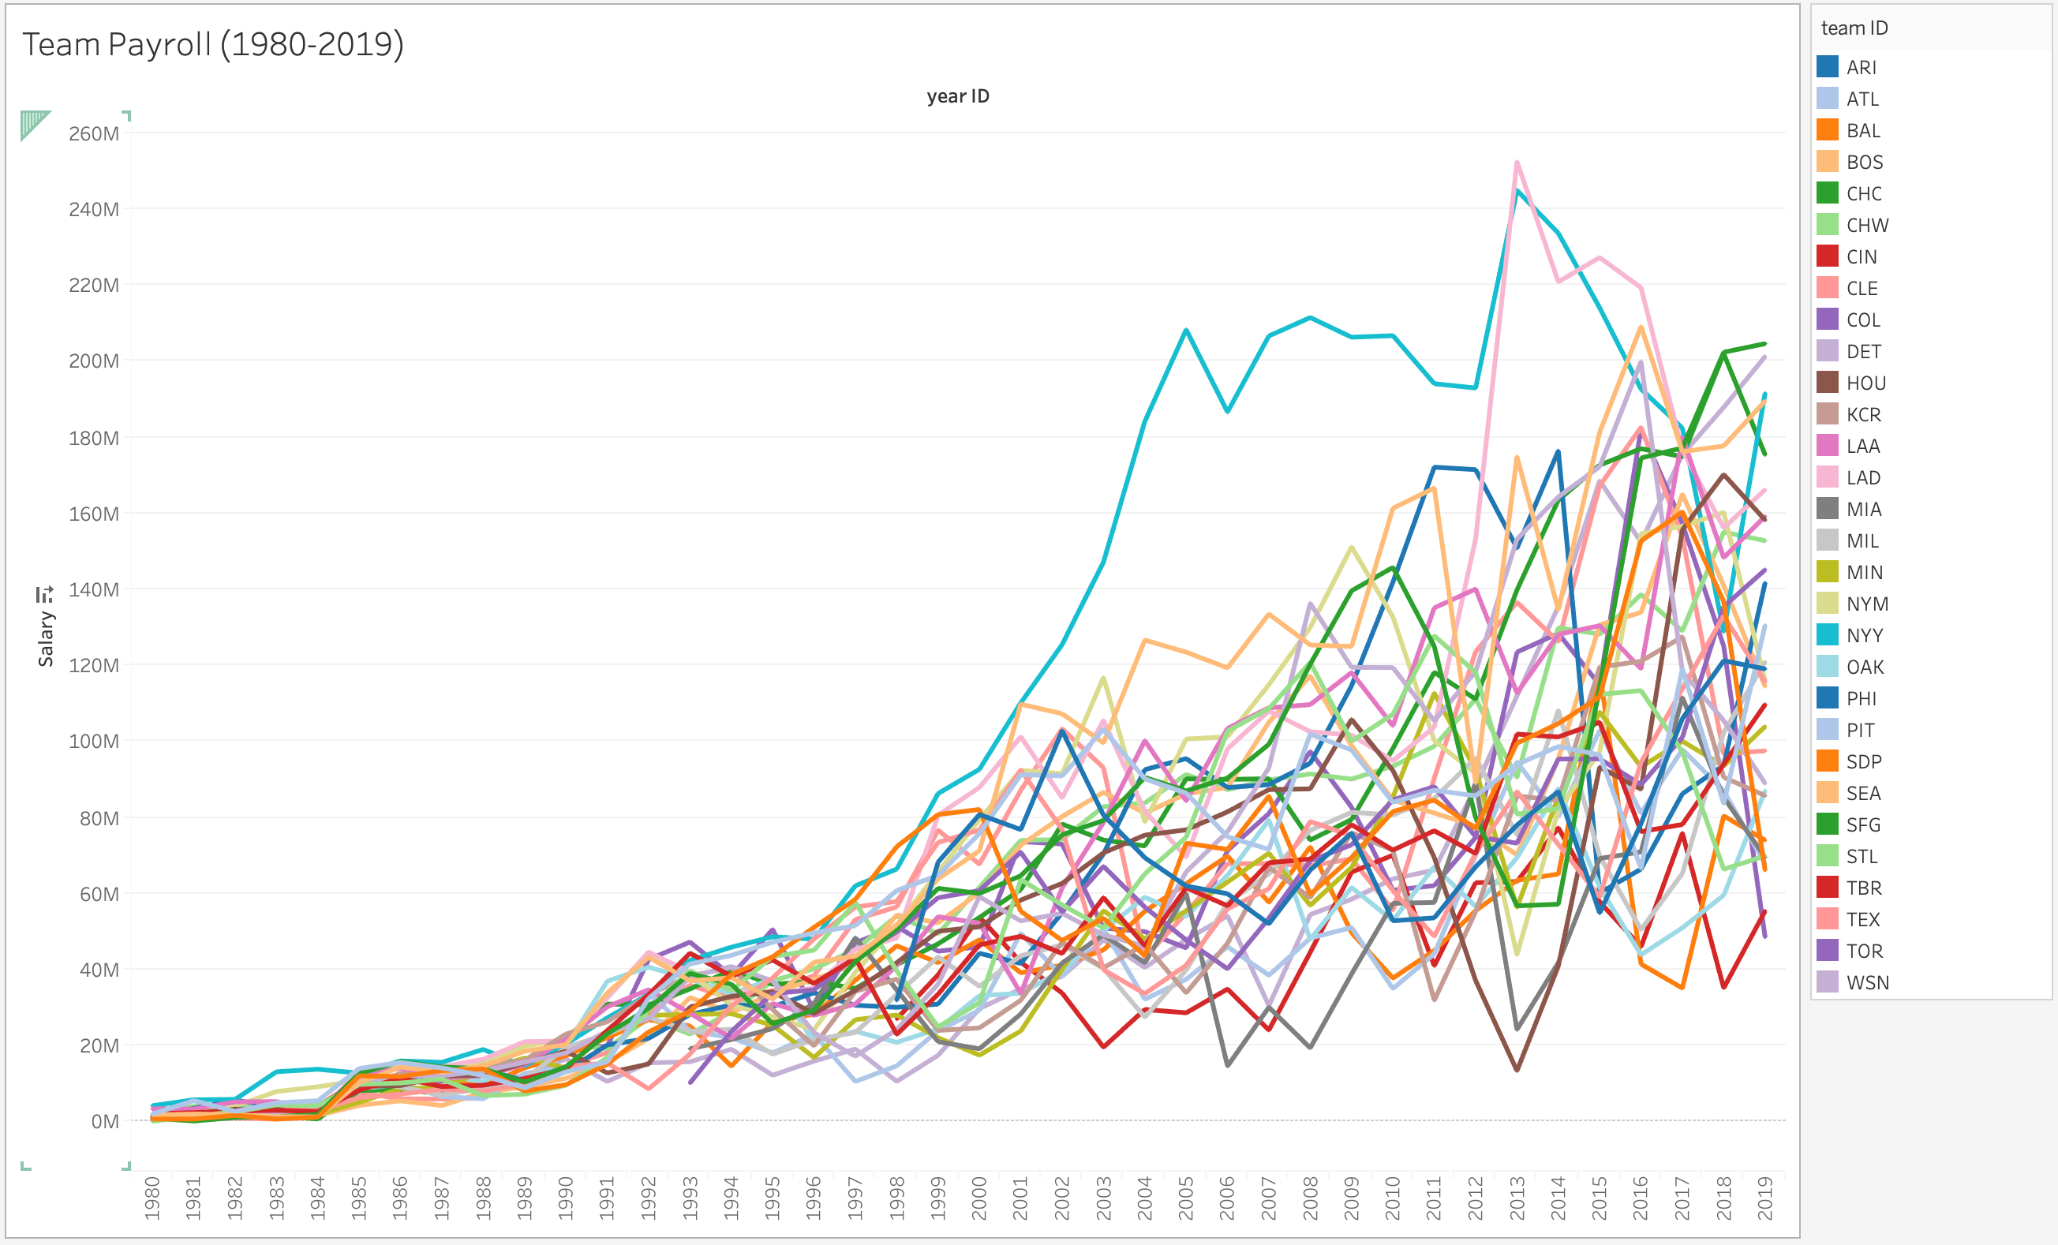

Slide 15
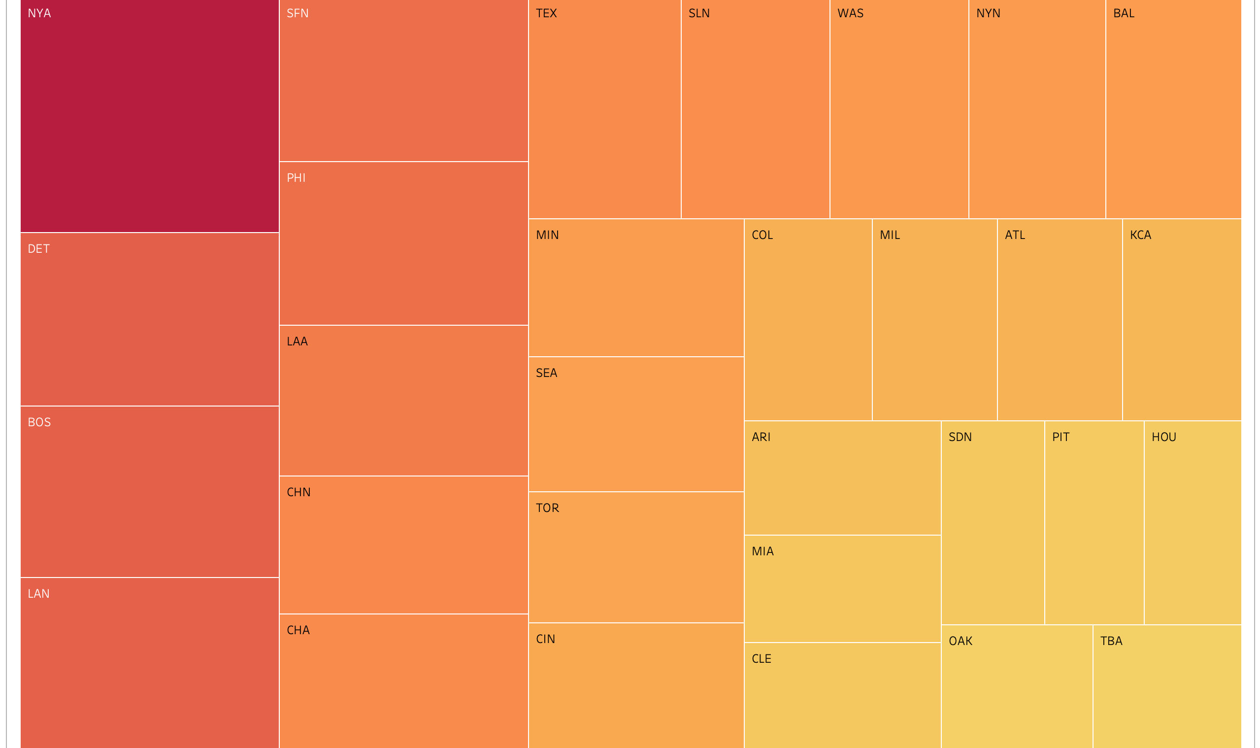
The Yankees Spend the More than any other team

Slide 16
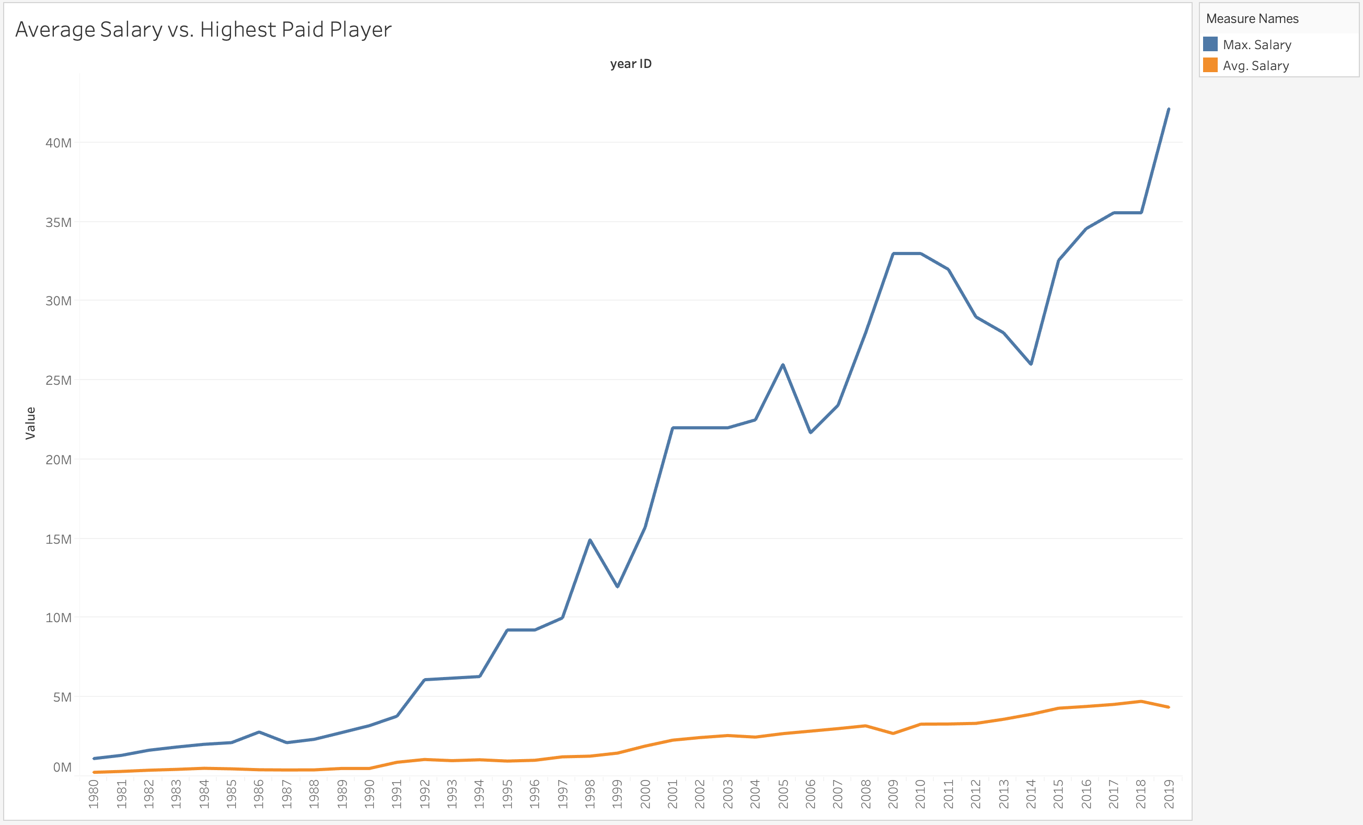

Slide 17
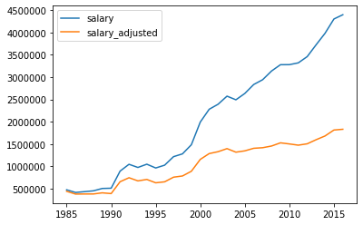
Player Salaries are Increasing Over Time at a rate much higher than inflation can explain by itself.
There is a significant difference year to year in salaries both in the 90s and the modern era.
1995-2000
Pvalue = 1.1e-12
2015-2019
Pvalue = 3.383-09
Average Salary vs. Inflation-Adjusted Average Salary

Slide 18
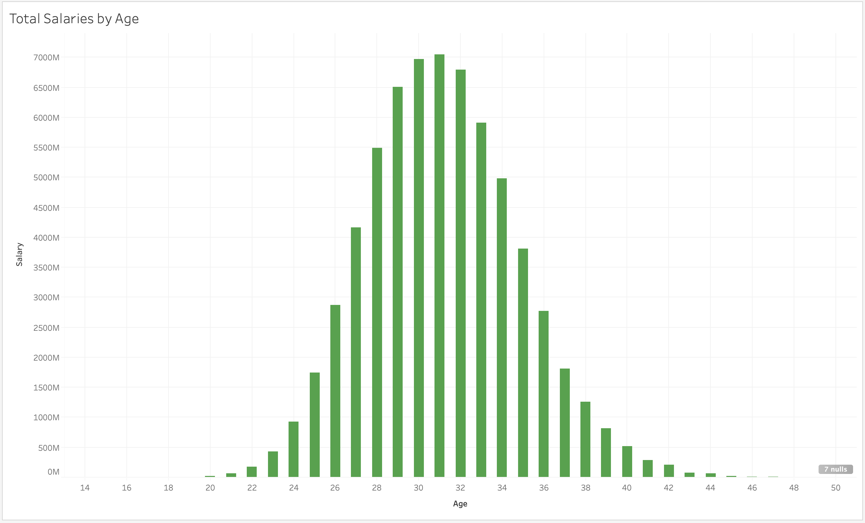
Nothing Influences Salary as much as factors of time. Factors such as;
Age,
Plate attempts
Innings played
As a player increases their opportunities for play they at the same time increase their likelihood for higher pay.

Slide 19
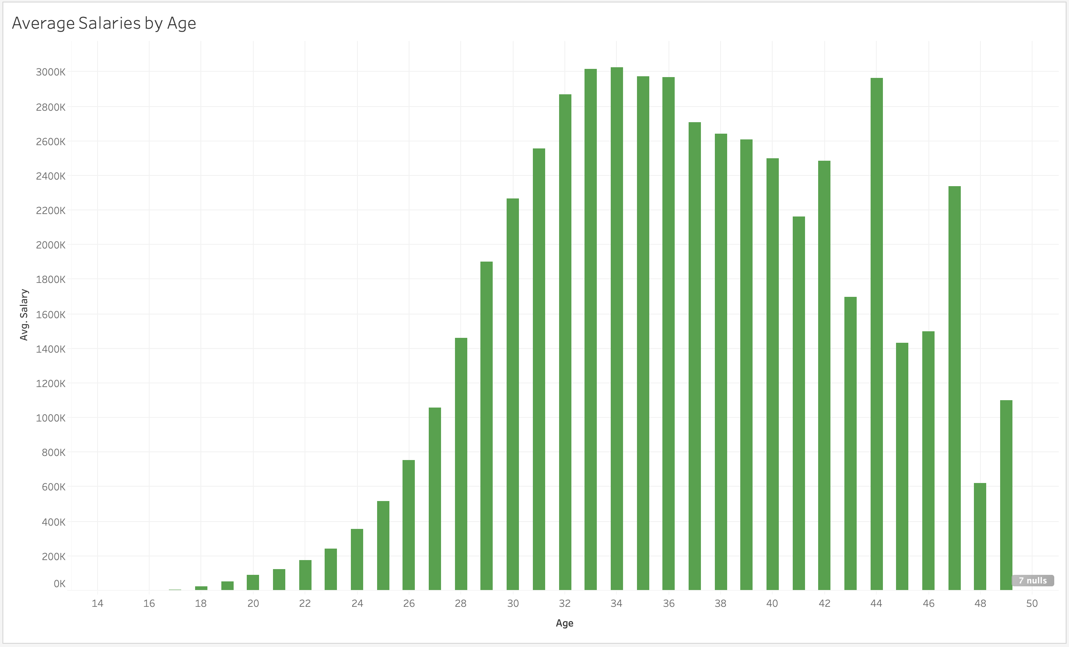
After running a repeated measures ANOVA we found that age had a significant impact on salary. Therefore as a player ages their salary changes also and these two factors go hand in hand throughout a players career.

Slide 20
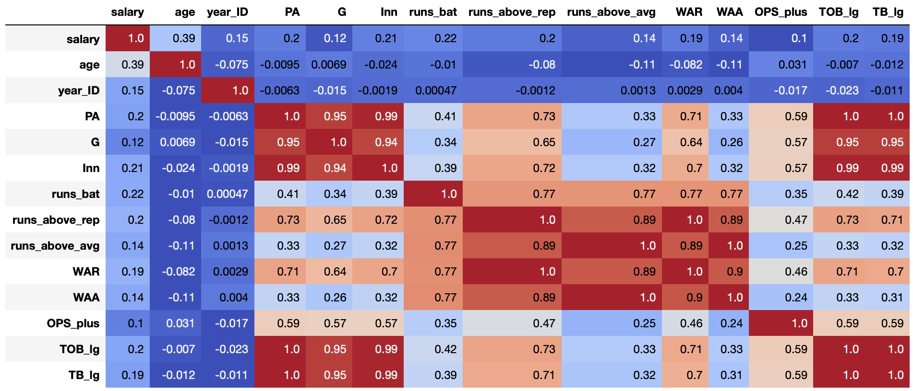

Slide 21
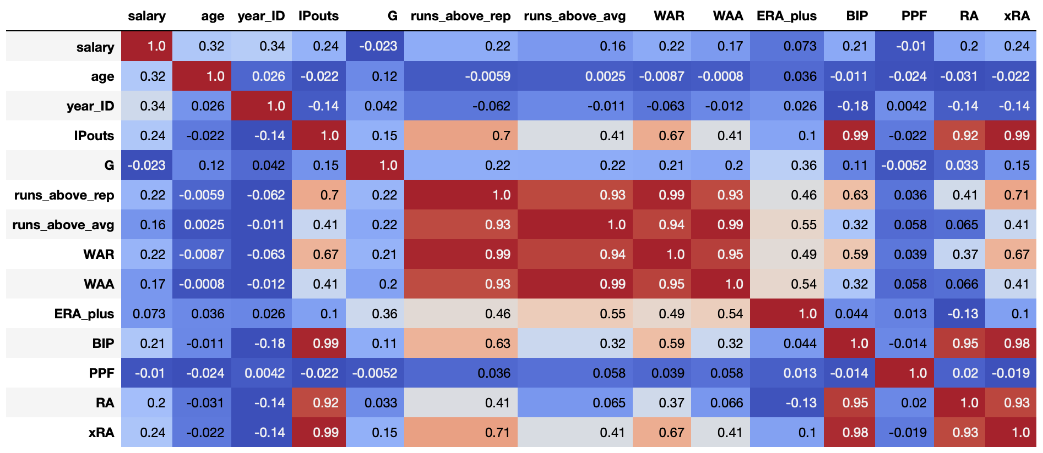

Slide 22
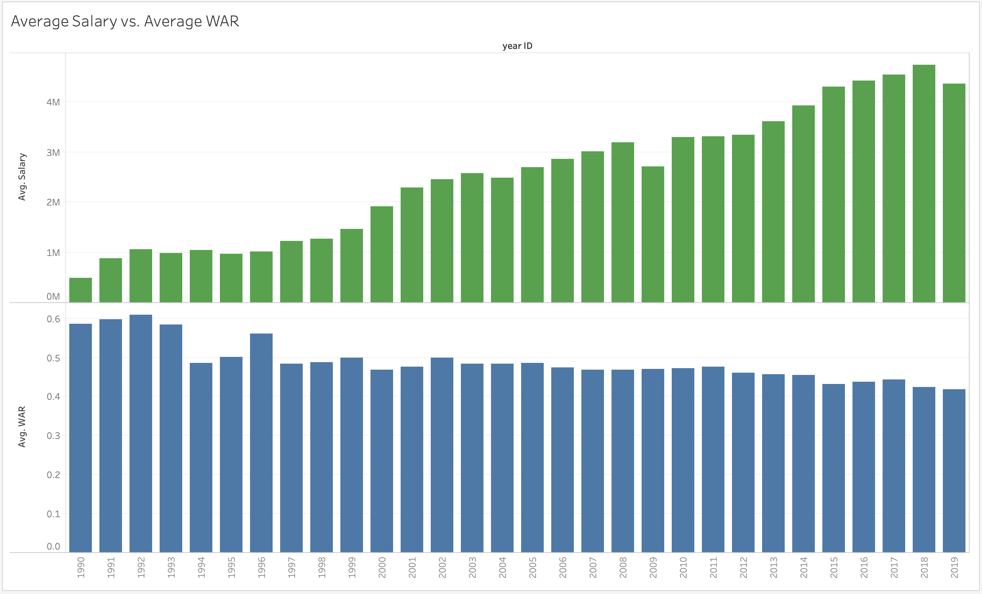
One surprising finding; a players performance on the field does not seem to automatically mean a player will be paid more.

Slide 23
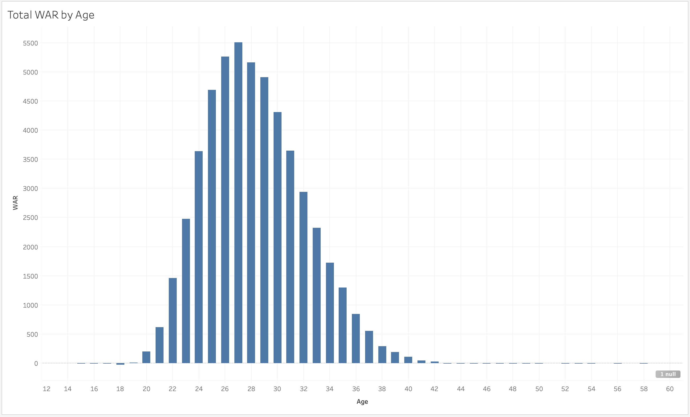

Slide 24
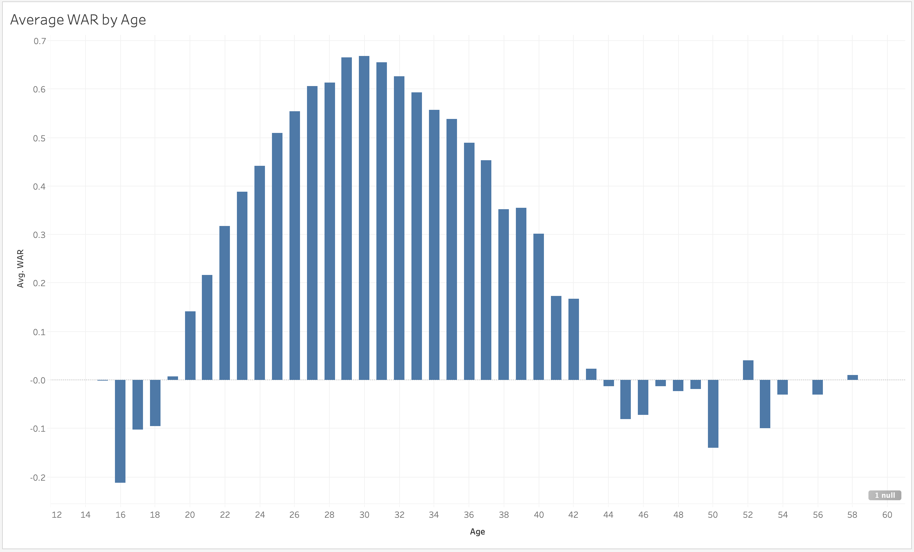

Slide 25
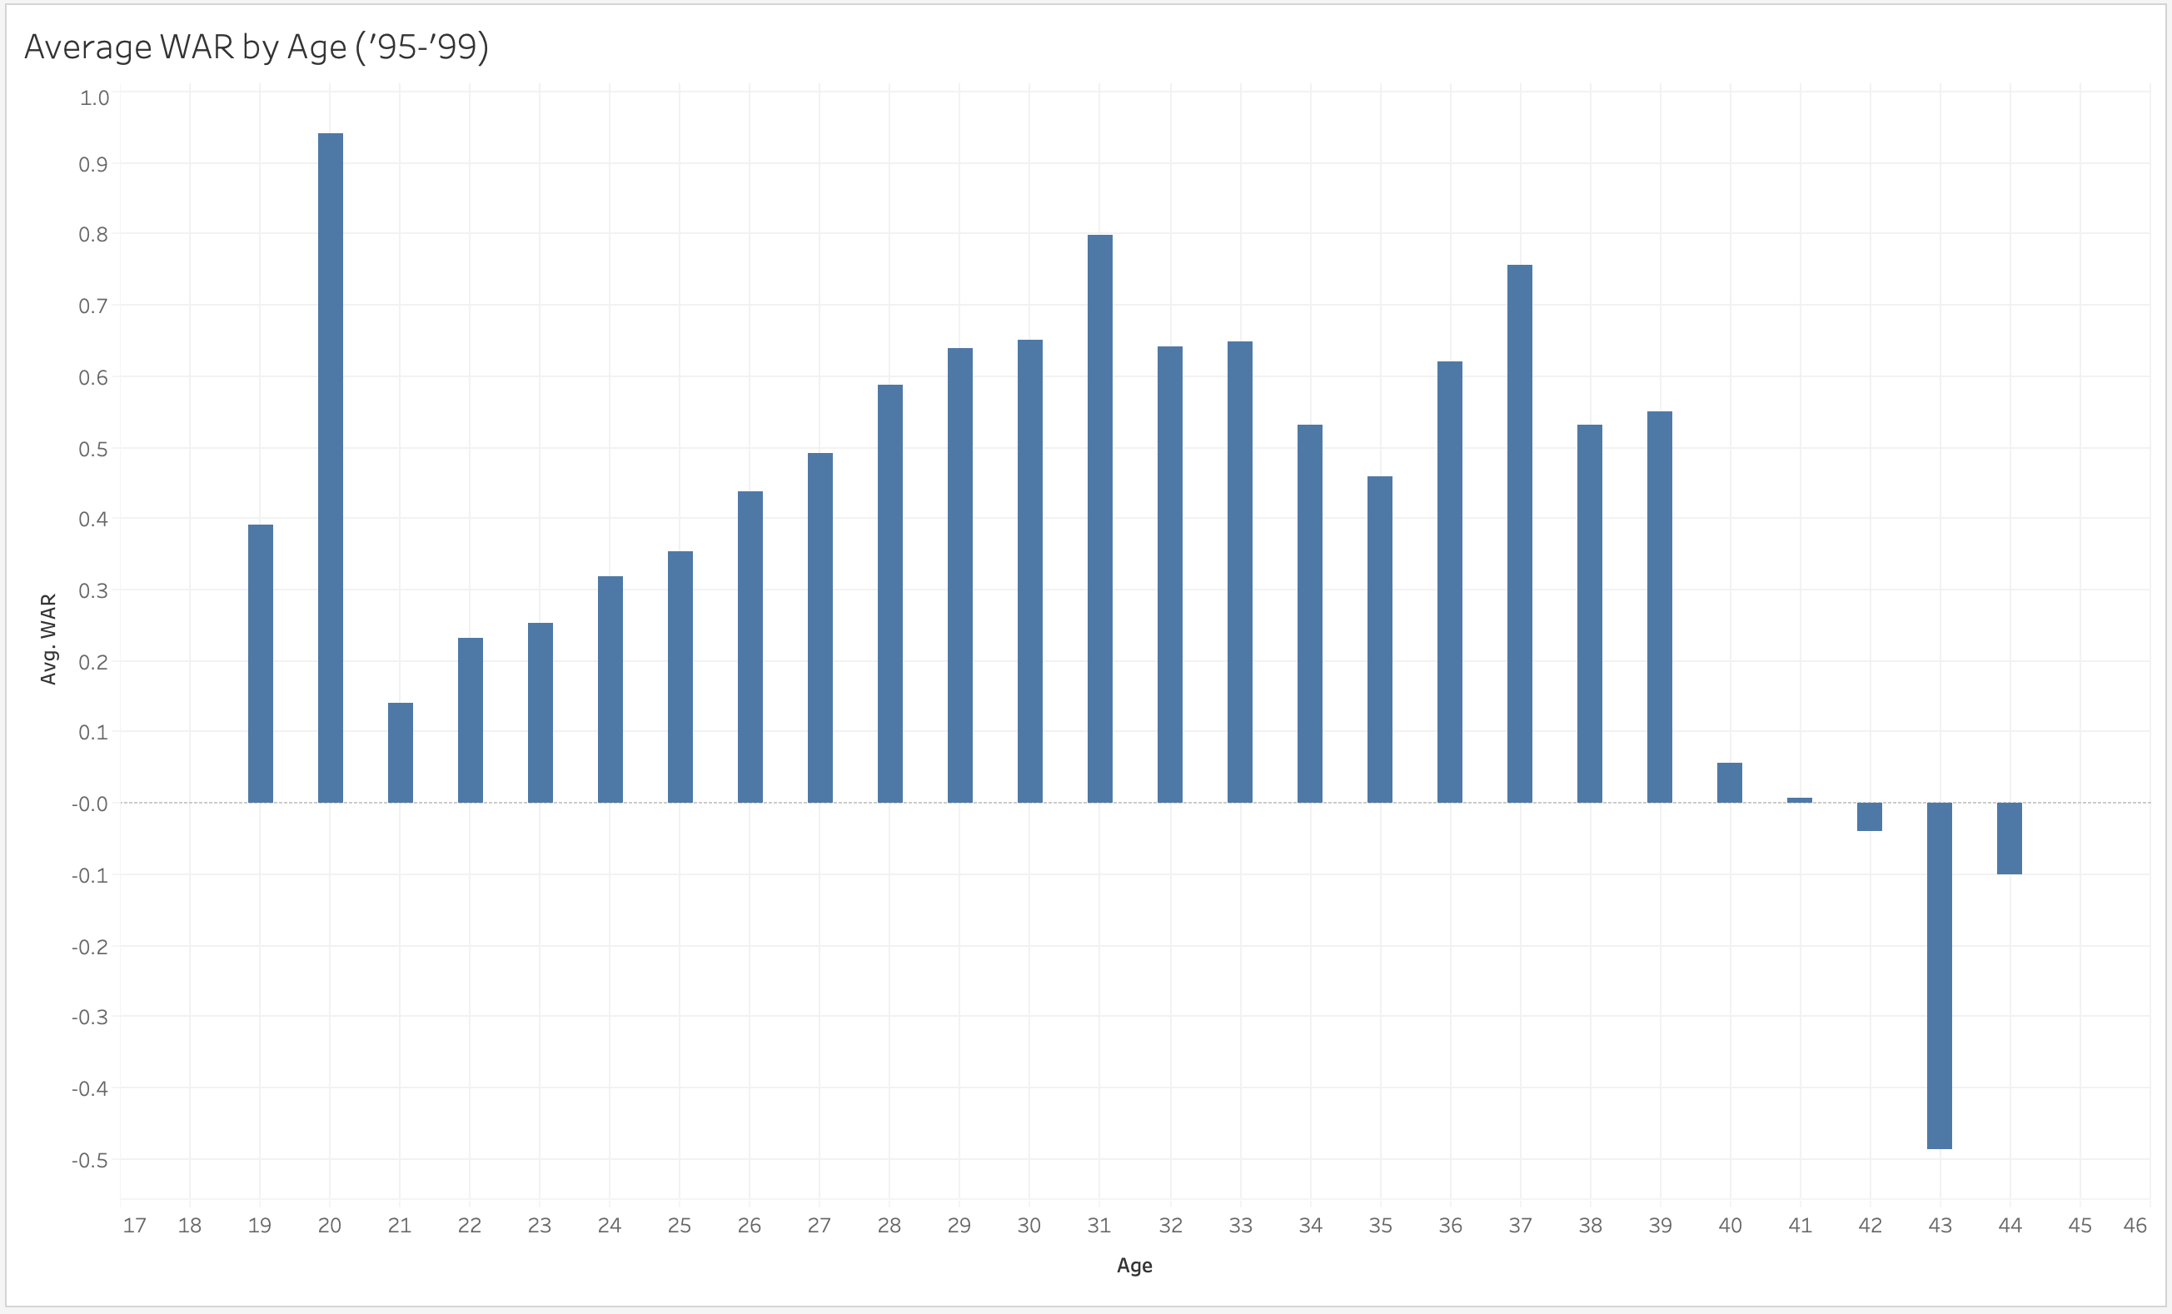

Slide 26
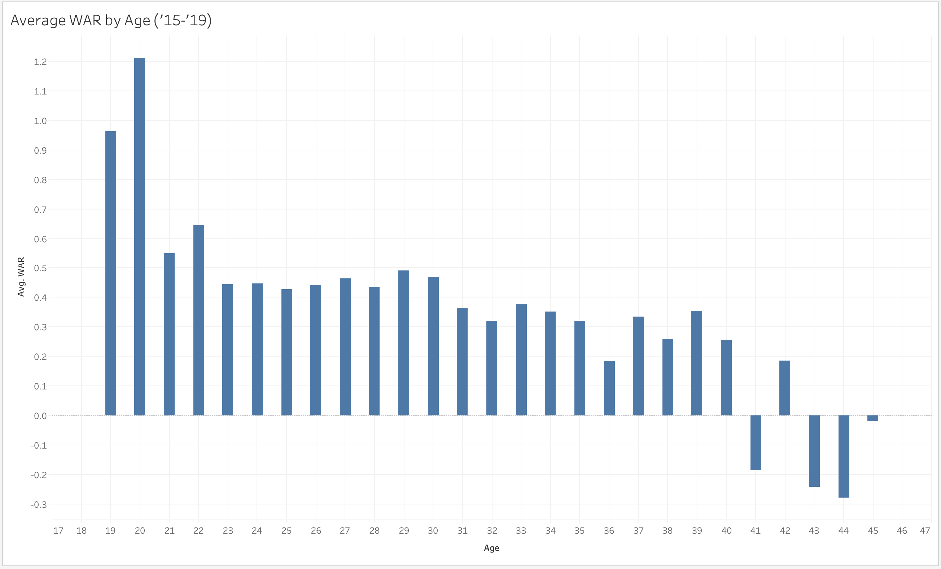

Slide 27
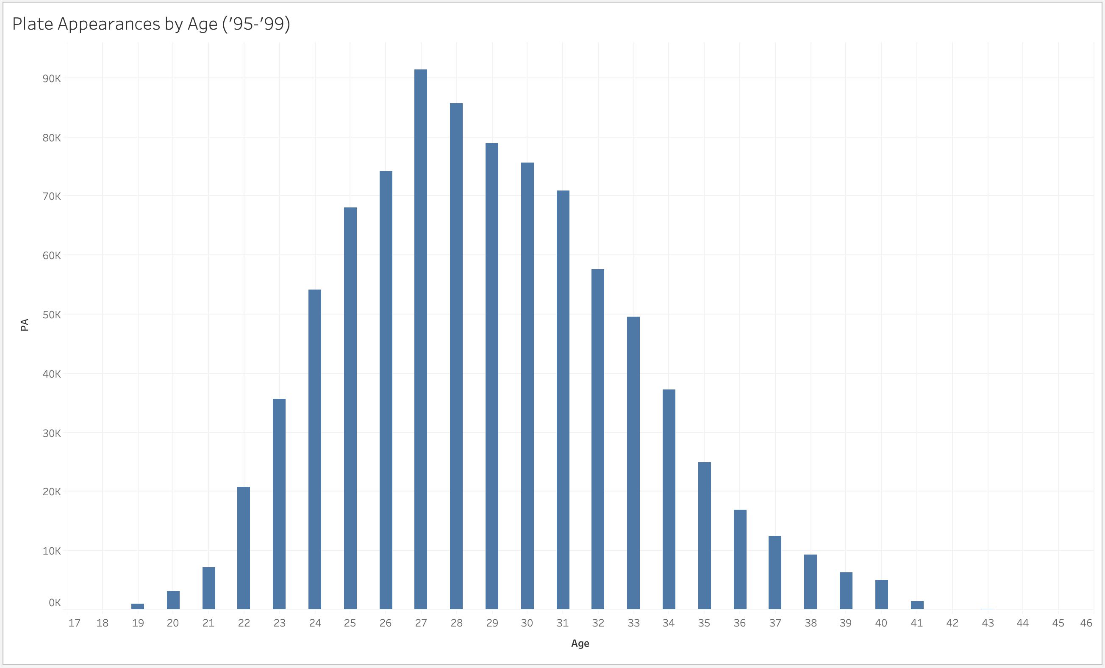

Slide 28
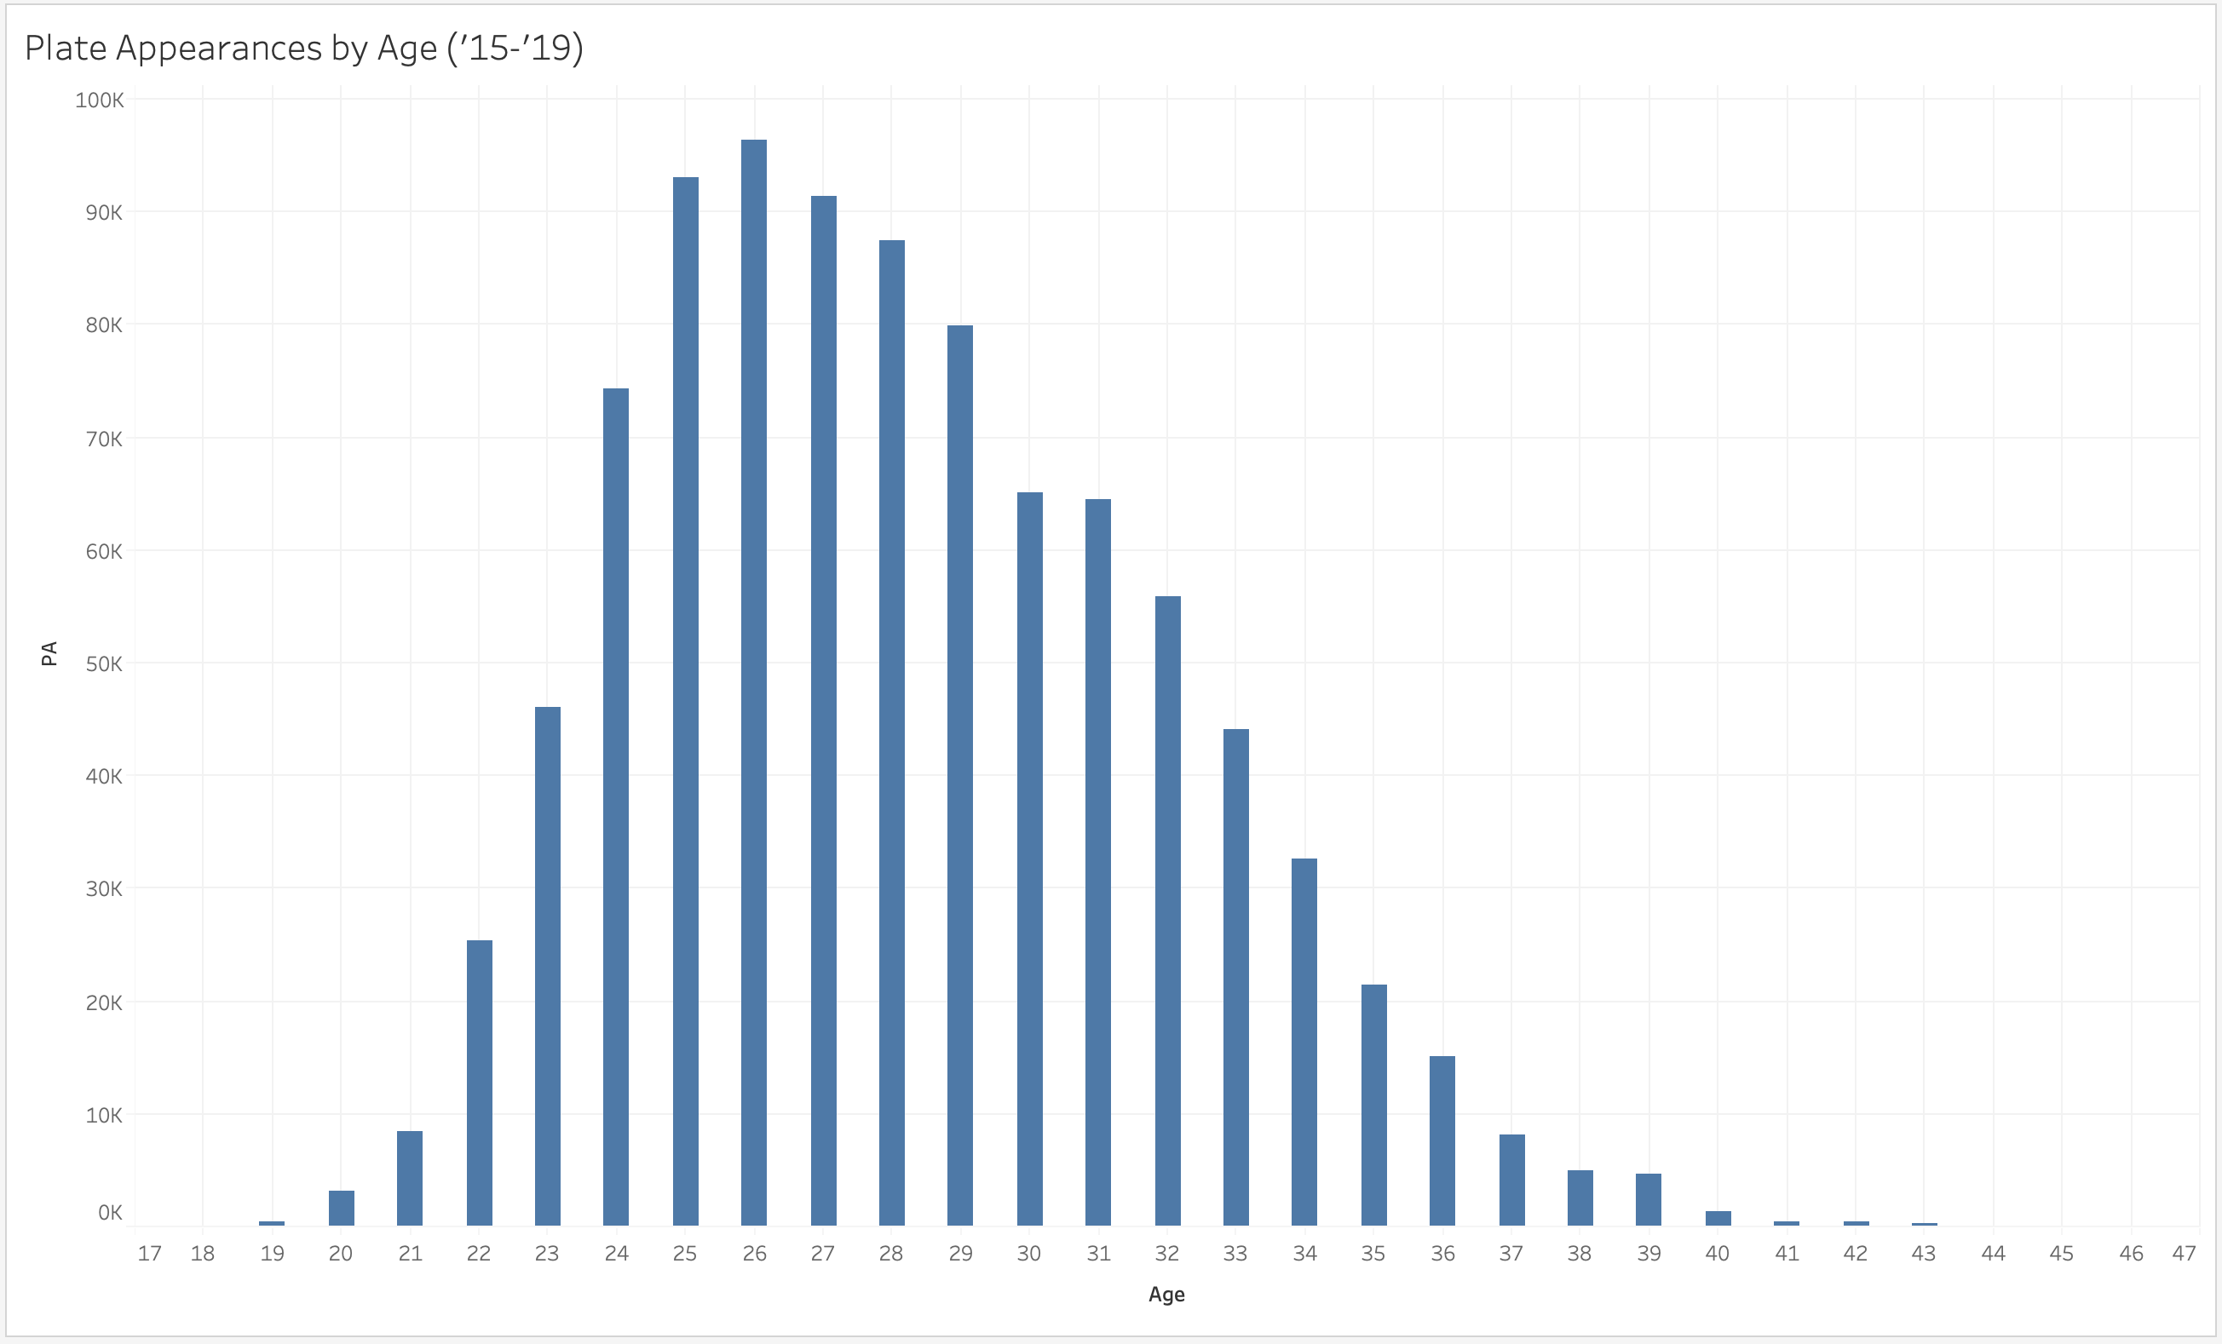

Slide 29
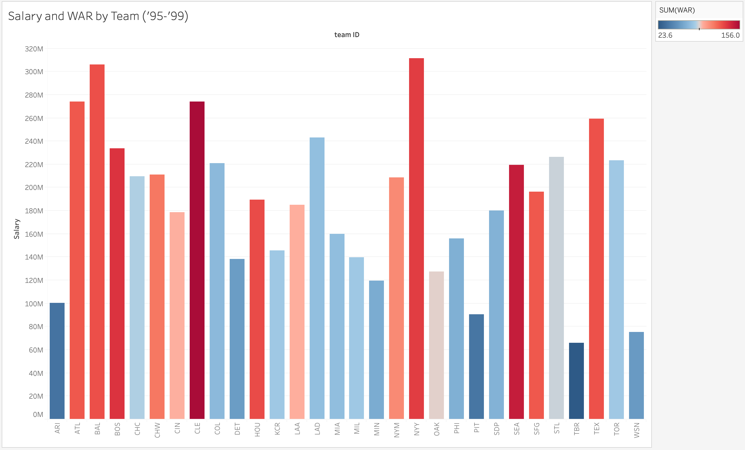

Slide 30
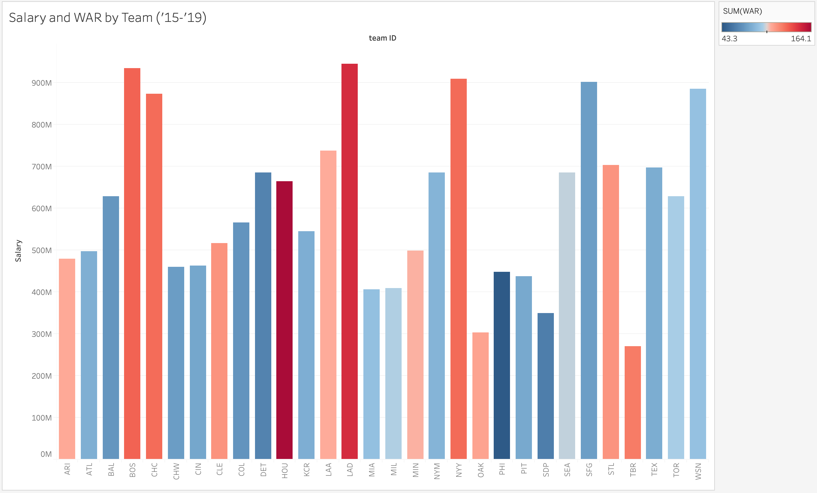

Slide 31
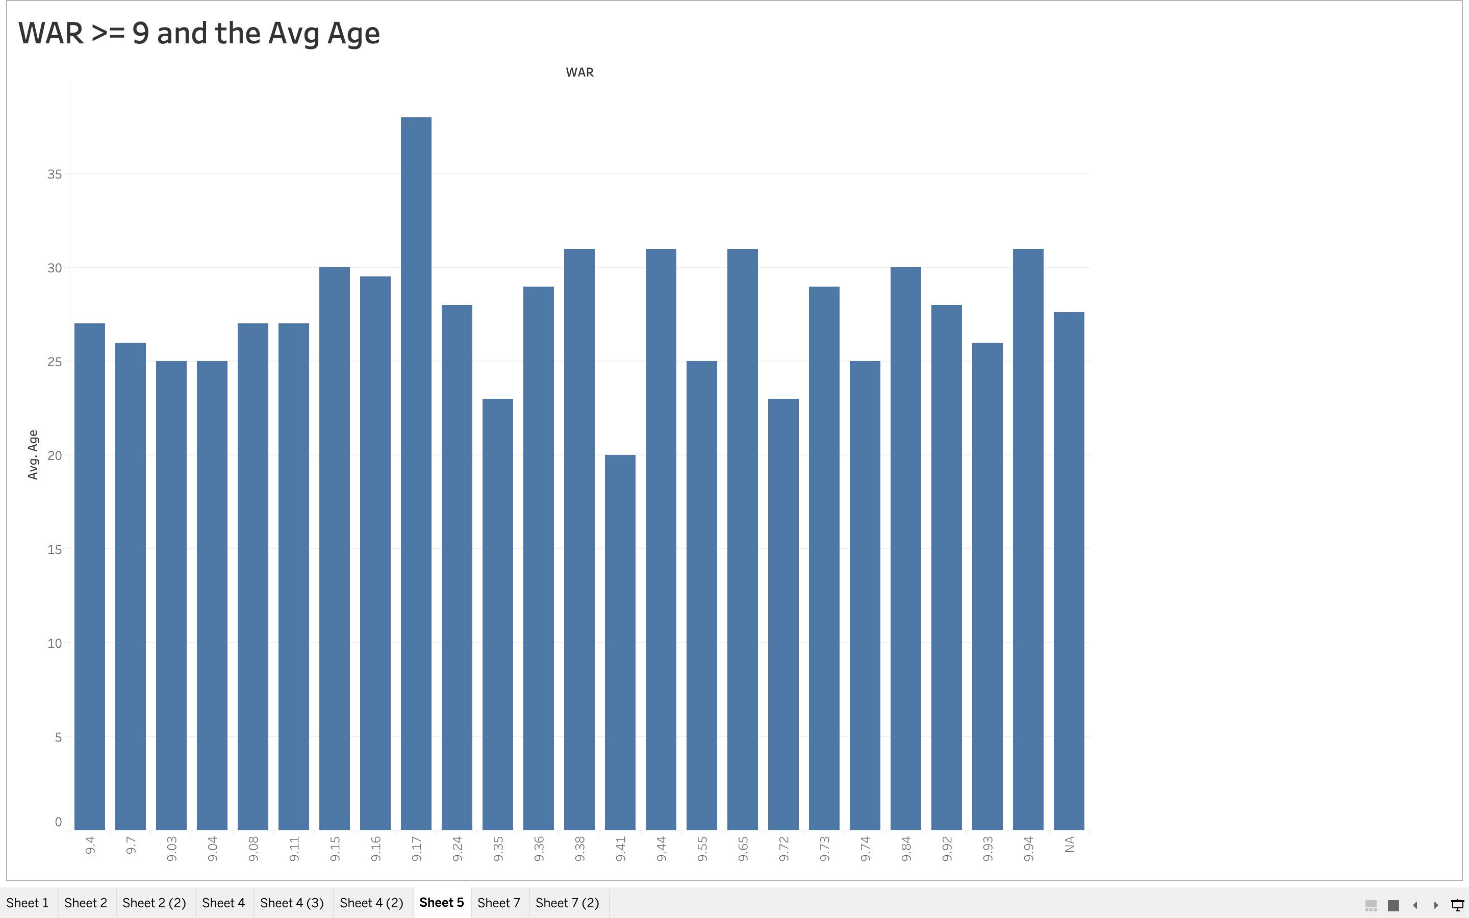
Younger players have higher war stats

Slide 32
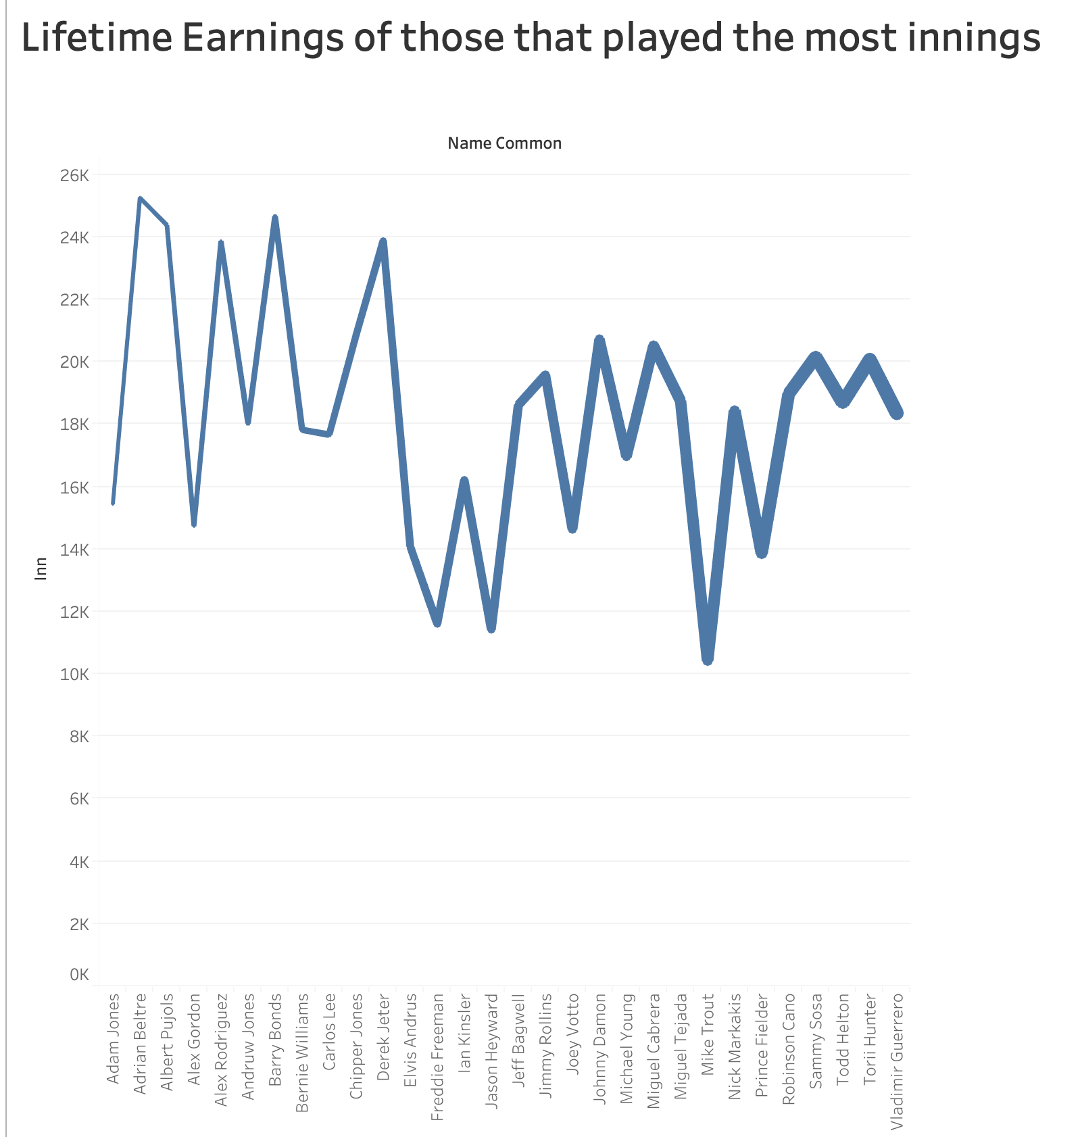
Lifetime earnings and innings played

Slide 33
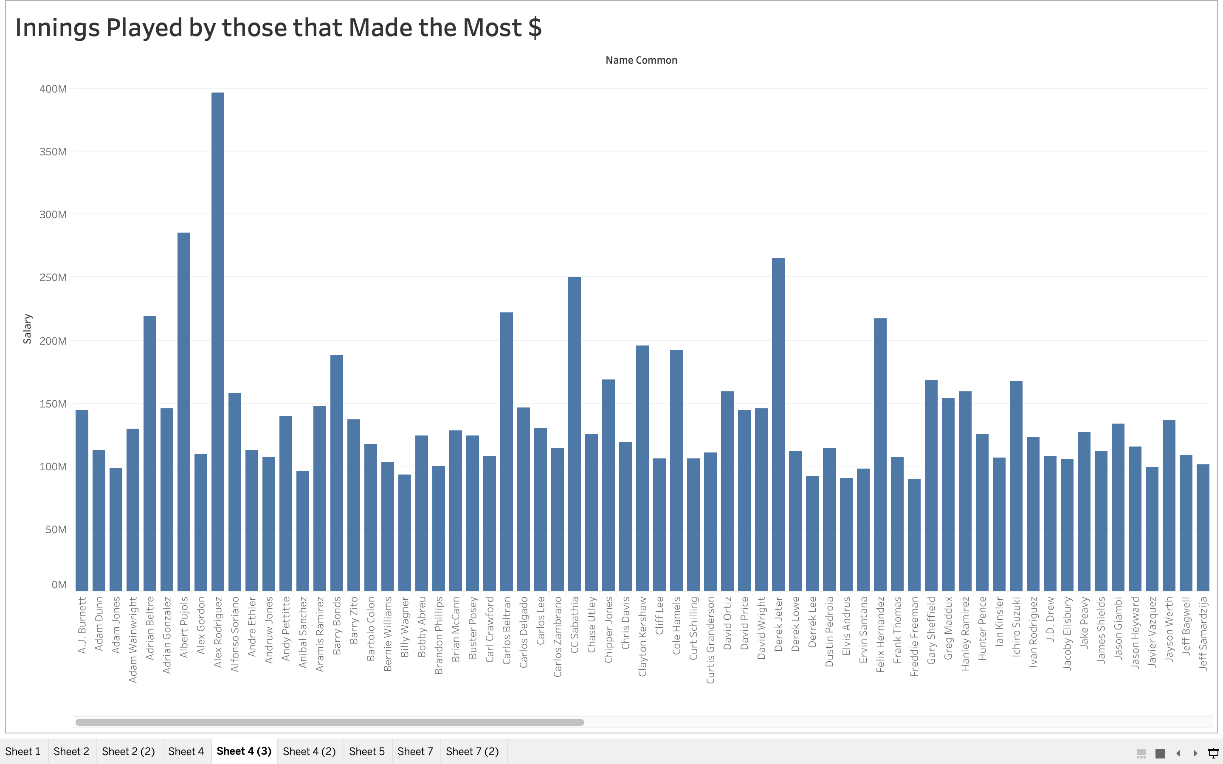
More Innings Played = More $

Slide 34
Summary
Teams are paying out higher salaries yes but the average player is still not making what the amount that they should based on their on the field play
Time and opportunities dictate a players earning power more than any other variable
In conclusion, one single season or even two great seasons will not necessarily mean a huge payday for a given player, only consistent good play over time will have a significant impact on player salary

Slide 35
Conclusions
Based on the data and our knowledge of the sport we were surprised by some of our results and would assume that there is more to this story.
Even though we identified a significant change in salary over time, we never really nailed down Why. Further research could focus on collecting more data on player contracts to understand if contract terms potentially caused a lack of immediate response in terms of salary to a players on the field play

Slide 36
Thanks for your time Questions?

